Slide 1

Codebasics
Resume Project Challenge #13
Provide Insights to Chief of Operations in Transportation Domain
Goodcabs Transportation Trends & Insights
Presented by
By Kalpana S

Slide 2
Agenda
1
Introduction
2
Key Metrics Overview
Overview of the project.
Explore key metrics.
3
Data Model
4
Primary Questions
Data structure and relationships.
Core inquiries driving the analysis.
5
Secondary Questions
6
Dashboard
Additional areas of exploration.
Visualization of findings.
7
Key Insights
8
Recommendations
Meaningful conclusions drawn.
Actionable steps based on data.

Slide 3

Introduction to Goodcabs
Cab service company established two years ago.
Focus on Tier-2 cities.
Committed to local drivers.
Ambitious performance targets for 2024.

Slide 4
🎯Key Metrics Overview
Total Trips
Revenue Performance.
Customer Satisfaction
Repeat Passenger Rate
Average fare per trip
Average fare per km
Average trip distance
Total , New, Repeated passengers

Slide 5
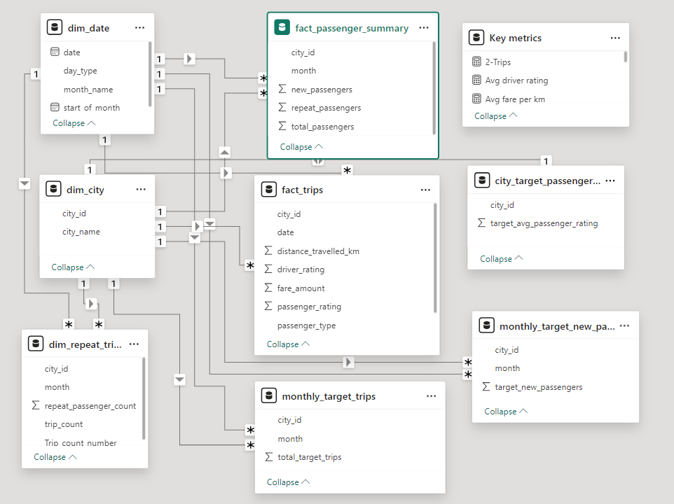
Data Model

Slide 6

Primary Questions
The primary questions are the key areas of focus for the analysis.

Slide 7
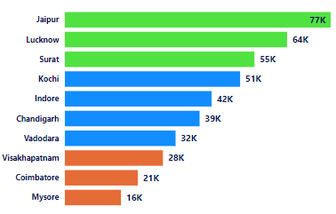
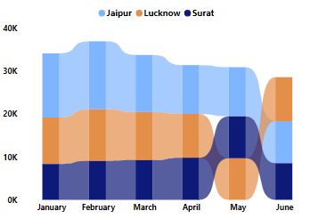
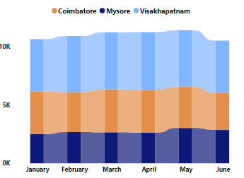
Q1.Identify the top 3 and Bottom 3 cities by total trips over the entire analysis period .
TOP 3 CITIES
BOTTOM 3 CITIES
Jaipur – 77K
Luknow-64K
Surath-55K
Mysore – 16K
Coimbathore-21K
Visakhapatnam-28K

Slide 8
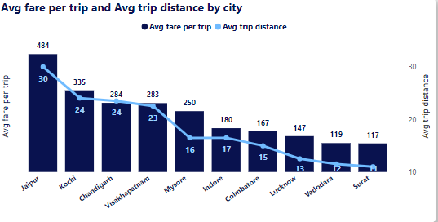
Q2. Average Fare per Trip by City
• Calculate the average fare per trip for each city and compare it with the city's average trip distance. Identify the cities with the highest and lowest average fare per trip to assess pricing efficiency across locations.
Highest avg fare per trip : Jaipur( 484 Rs)
Lowest avg fare per trip : Surat(117 Rs)

Slide 9
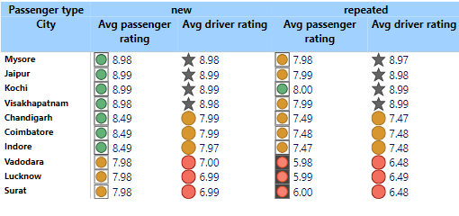
Q3. Average Ratings by City and Passenger Type
• Calculate the average passenger and driver ratings for each city, segmented by passenger type (new vs. repeat). Identify cities with the highest and lowest average ratings.
Highest rating cities
Mysore
Jaipur
Kochi
Lowest rating cities
Surat
Lucknow
Vadodara

Slide 10
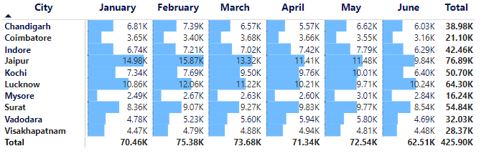
Q4. Peak and Low Demand Months by City
• For each city, identify the month with the highest total trips (peak demand) and the month with the lowest total trips (low demand). This analysis will help Goodcabs understand seasonal patterns and adjust resources accordingly.
city | Peak month | Low month
Chandigarh | Feb,Jan | Apr,Jun
Coimbatore | Mar,Jan | Jun,Feb
Indore | May,Apr | Jun,Jan
Jaipur | Feb,Jan | Jun,Apr
Kochi | May,Apr | Jun,Jan
Lucknow | Feb,Mar | May,Apr
Mysore | May,Jun | Jan,Apr
Surat | Apr,May | Jan,Jun
Vadodara | Apr,May | Jan,Jun
Vizag | Apr,Mar | Jan,Jun

Slide 11
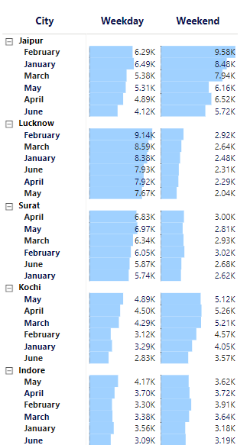
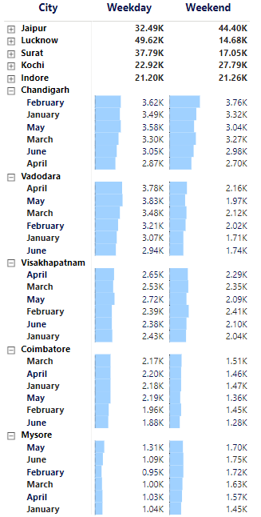
Q5. Weekend vs. Weekday Trip Demand by City
• Compare the total trips taken on weekdays versus weekends for each city over the six-month period. Identify cities with a strong preference for either weekend or weekday trips to understand demand variations.
Weekday trip demand Cities
Lucknow
Surat
Chandigarh
Vadodara
Visakhapatnam
Coimbatore
Indore
Weekend trip demand Cities
Jaipur
Kochi
Mysore

Slide 12
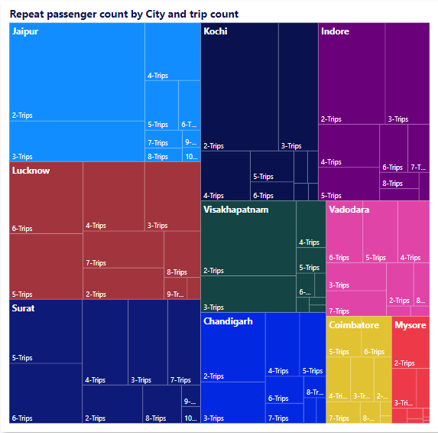
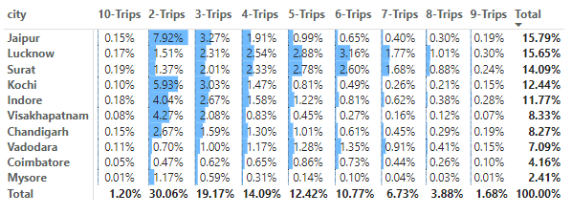
Q6. Repeat Passenger Frequency and City Contribution Analysis
Analyze the frequency of trips taken by repeat passengers in each city (e.g., % of repeat passengers taking 2 trips, 3 trips, etc.). Identify which cities contribute most to higher trip frequencies among repeat passengers, and examine if there are distinguishable patterns between tourism-focused and business-focused cities.
Cities contributing to higher trip frequencies (multiple trips) include Jaipur, Kochi, and Lucknow, with Jaipur showing particularly high frequencies due to its tourism-driven demand.
Tourism-focused cities show spikes in repeat trip frequencies during peak tourist months, while business-focused cities exhibit consistent repeat trips due to professional or local commuting patterns.

Slide 13
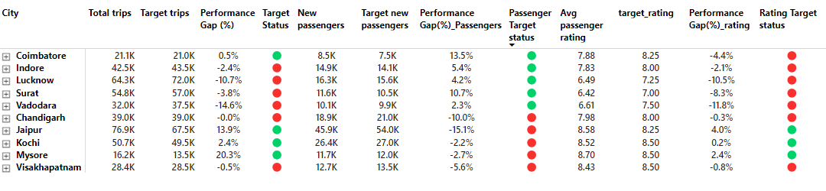
Q7.Monthly Target Achievement Analysis for Key Metrics
• For each city, evaluate monthly performance against targets for total trips, new passengers, and average passenger ratings from targets_db. Determine if each metric met, exceeded, or missed the target, and calculate the percentage difference. Identify any consistent patterns in target achievement, particularly across tourism versus business-focused cities.

Slide 14
Month | Target trips | Target new passengers | Avg passenger rating
January, June | ❌ | ❌ | ❌
April | ✅ | ✅ | ❌
February,March,May | ✅ | ❌ | ❌
City | Target trips | Target new passengers | Avg passenger rating
Chandigarh,Vishakapatnam | ❌ | ❌ | ❌
Coimbatore | ✅ | ✅ | ❌
Indore,Lukhnow,Surat,Vadodara | ❌ | ✅ | ❌
Jaipur,Kochi,Mysore | ✅ | ❌ | ✅
*Business cities successfully reached their target for new passengers, while tourism cities achieved their targets for ratings and total trips.

Slide 15
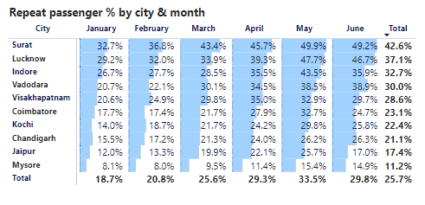
Q8. Highest and Lowest Repeat Passenger Rate (RPR%) by City and Month
Analyze the Repeat Passenger Rate (RPR%) for each city across the six- month period.
Identify the top 2 and bottom 2 cities based on their RPR% to determine which locations have the strongest and weakest rates. Similarly, analyze the RPR% by month across all cities and identify the months with the highest and lowest repeat passenger rates. This will help to pinpoint any seasonal patterns or months with higher repeat passenger loyalty.
RPR%
Highest Month - May
Lowest month - Jan
Top 2 cities
Surat
Lucknow
Bottom 2 cities
Mysore
Jaipur

Slide 16

Secondary Questions
The secondary questions provide further insights into the primary questions.

Slide 17
Q1.Factors influencing Repeat passenger rate
• What factors (such as quality of service, competitive pricing, or city demographics) might contribute to higher or lower repeat passenger rates in different cities? Are there correlations with socioeconomic or lifestyle patterns in these cities?
Quality of Service: High-quality service leads to higher repeat rates (seen in Jaipur, Kochi, and Mysore).
Competitive Pricing: Affordability and value for money can increase repeat usage, but premium pricing in cities like Jaipur is justified by higher quality.
City Demographics: Business hubs (like Lucknow) have high repeat rates due to daily needs, whereas tourism-centric cities (like Jaipur and Kochi) face more seasonal demand.
Fleet Availability: Ensuring availability during peak times increases repeat customers by enhancing convenience and reliability.
Seasonality of Demand: Cities with seasonal tourism (like Mysore) need year-round engagement strategies to boost repeat rates.

Slide 18
Q2.Tourism versus Business demand impact
• How do tourism seasons or local events (festivals, conferences) impact Goodcabs' demand patterns? Would tailoring marketing efforts to these events increase trip volume in tourism-oriented cities?
1. Tourism Demand Impact
Tourism Seasons: High demand during peak seasons (e.g., winter months in Jaipur, Kochi); lower demand off-season, offset by local events.
Local Events: Festivals, fairs, and conferences (e.g., Pushkar Camel Fair) create spikes in demand for tourist transport.
Marketing Strategies:
Promotions: Offer discounts for tourists during peak periods.
Partnerships: Collaborate with hotels and attractions for discounted rides.
Customized Packages: City tours, airport transfers, and unlimited ride passes.
2. Business Demand Impact
Business Travel: Higher demand on weekdays, focused on commuting, meetings, and airport transfers.
Local Business Events: Conferences and trade fairs (e.g., Lucknow, Vadodara) increase need for group or corporate transport.
Marketing Strategies:
Corporate Partnerships: Offer discounts for frequent business travelers.
Loyalty Programs: Encourage regular use with business rewards or subscriptions.
Event-Based Marketing: Promotions during business events or conventions.

Slide 19

Q3.Emerging mobility trends and Goodcabs Adaptation
• What emerging mobility trends (such as electric vehicle adoption, green energy use) are impacting the cab service market in tier-2 cities? Should Goodcabs consider integrating electric vehicles or eco-friendly initiatives to stay competitive?
Electric Vehicle (EV) Adoption
Green Energy Use
Shared Mobility and Ride-Pooling
Digital Platforms and AI-Driven Solutions
Autonomous Vehicles (Long-Term Trend)
Yes, Good Cabs should consider integrating EVs and eco-friendly initiatives to stay competitive, especially in tier-2 cities where sustainability is becoming an increasingly important factor for consumers.

Slide 20



Q4.Partnership opportunities with local business
• Are there opportunities for Goodcabs to partner with local businesses (such as hotels, malls, or event venues) to boost demand and improve customer loyalty? Could these partnerships drive more traffic, especially in tourism- heavy or high-footfall areas?
Collaborate with hotels to offer airport transfers, city tours, and discounted rides for guests.
Partner with malls to provide valet parking and promotional ride packages for shoppers.
Collaborate with event organizers to offer shuttle services and special packages for attendees.
These partnerships offer multiple avenues to:
Increase trip volume in tourism-heavy areas (by offering rides to and from popular destinations).
Attract repeat business through loyalty programs or special promotions.
Enhance brand visibility by associating Good Cabs with major local events, venues, or attractions.
By tailoring partnership offers to the specific needs of each local business (e.g., offering discounts, loyalty rewards, or special bundles), Good Cabs can create a stronger connection with customers and ensure continued growth in both tourism and business-driven markets.

Slide 21
Q5. Data Collection for Enhanced Data-Driven Decisions
• To make Goodcabs more data-driven and improve its performance across key metrics (such as repeat passenger rate, customer satisfaction, new passengers and trip volume), what additional data should Goodcabs collect? Consider data that could provide deeper insights into customer behavior, operational efficiency, and market trends.
To make Good Cabs more data-driven and improve key metrics like repeat passenger rate, customer satisfaction, new passengers, and trip volume, it’s essential to collect comprehensive data across several areas. This includes:
Customer behavior data (e.g., trip patterns, preferences, feedback).
Operational efficiency data (e.g., vehicle performance, driver efficiency).
Market trends data (e.g., competitor performance, local events, economic trends).
Advanced analytics for predictive insights (e.g., demand forecasting, churn prediction).

Slide 22
Ad-hoc Requests

Slide 23
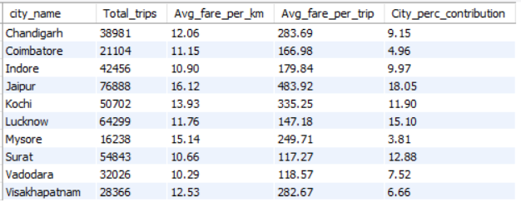
Business Request-1: City-Level Fare and Trip Summary Report

Slide 24
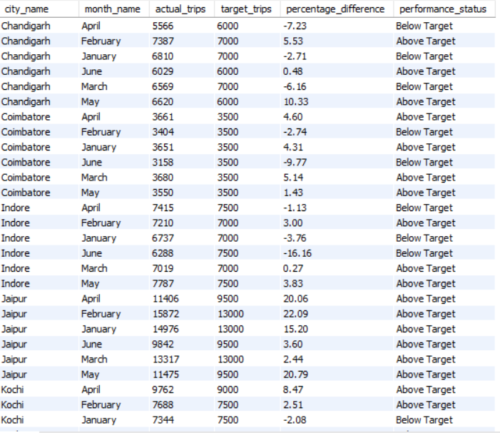
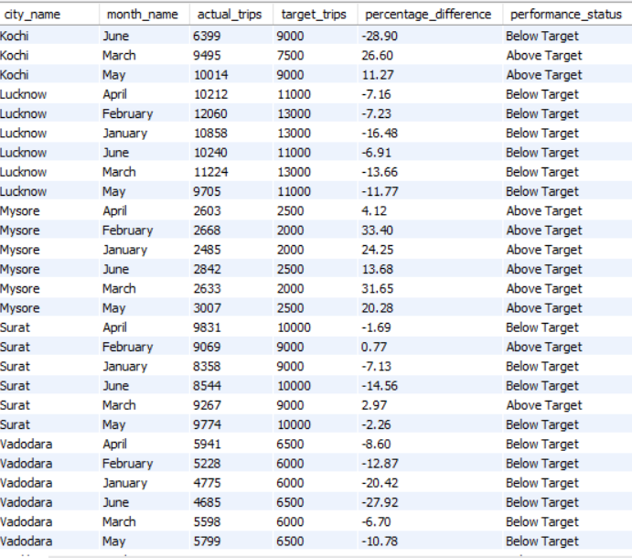
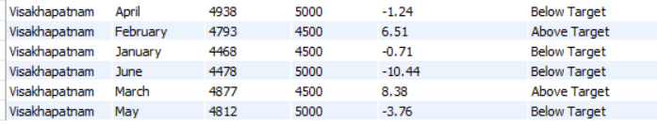
Business Request-2: Monthly City-Level Trips Target Performance Report

Slide 25
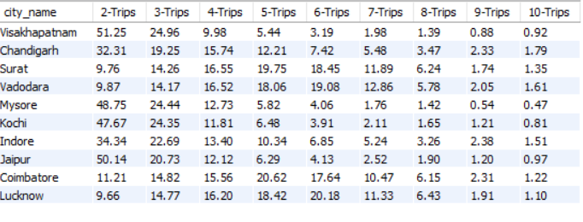
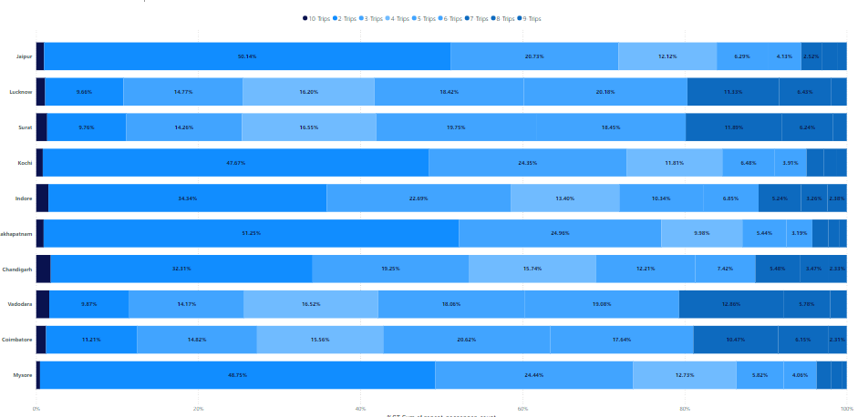
Business Request-3: City-Level Repeat Passenger Trip Frequecy Report

Slide 26
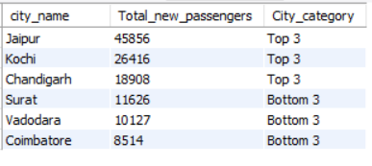
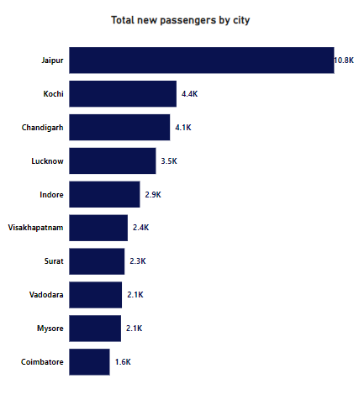
Business Request:4 Identify cities with highest and lowest total new passengers

Slide 27
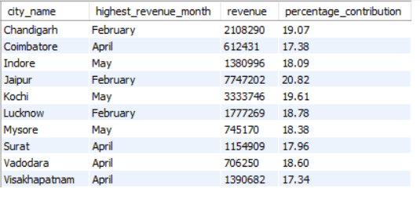
Business Request-5: Identify Month with Highest Revenue for Each City

Slide 28
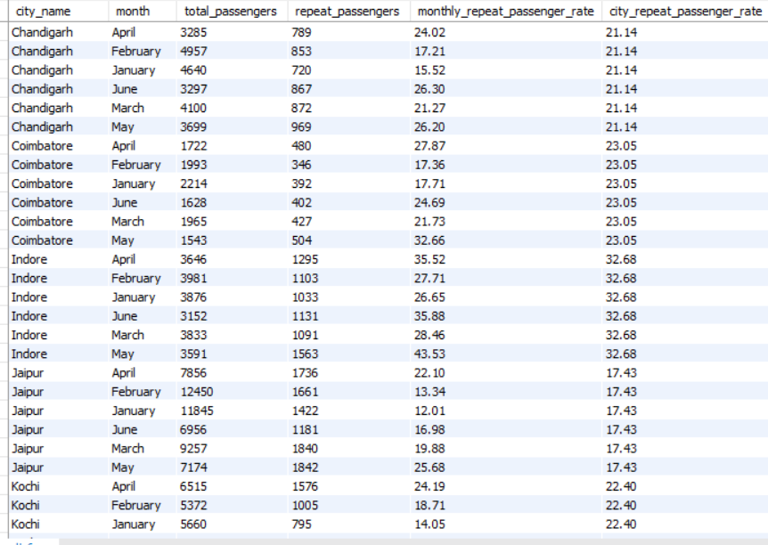
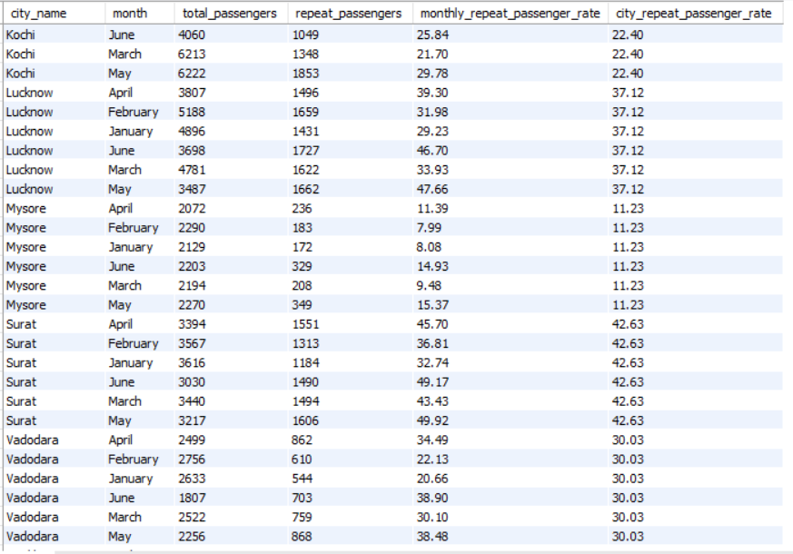
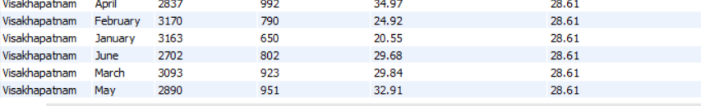
Business Request-6: Repeat Passenger Rate Analysis

Slide 29
Dashboard

Slide 30
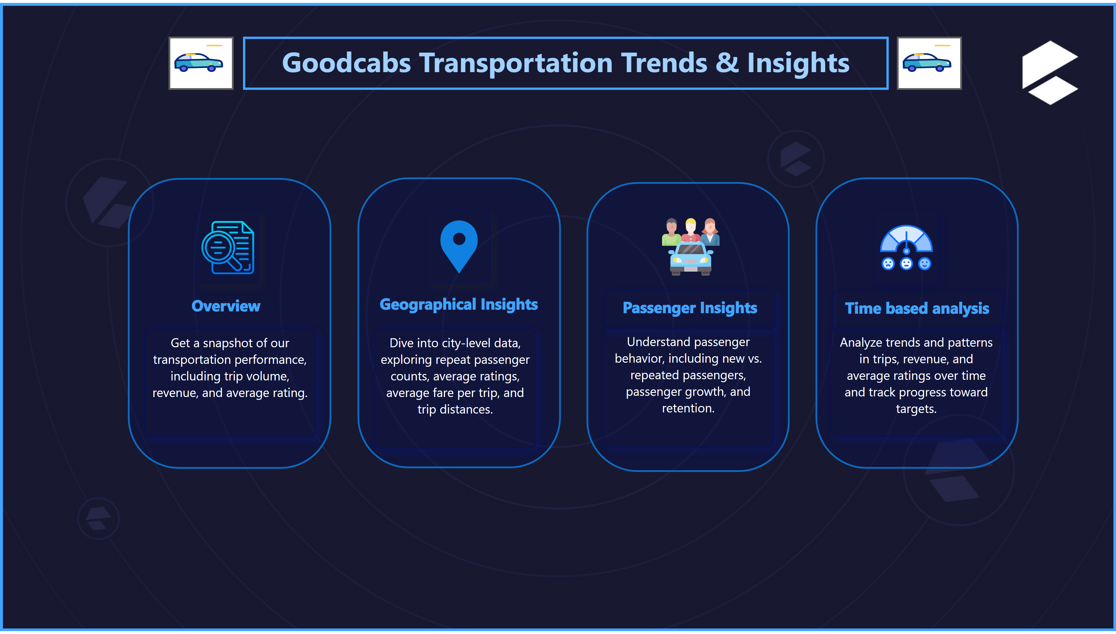
Home
Notes:
textbox
No alt text provided
over Image
No alt text provided
textbox
No alt text provided
textbox
No alt text provided
shape
No alt text provided
Geo Image
No alt text provided
textbox
No alt text provided
textbox
No alt text provided
shape
No alt text provided
actionButton
No alt text provided
actionButton
No alt text provided
textbox
No alt text provided
textbox
No alt text provided
Perf Image
No alt text provided
shape
No alt text provided
textbox
No alt text provided
textbox
No alt text provided
image
No alt text provided
shape
No alt text provided
textbox
No alt text provided

Slide 31
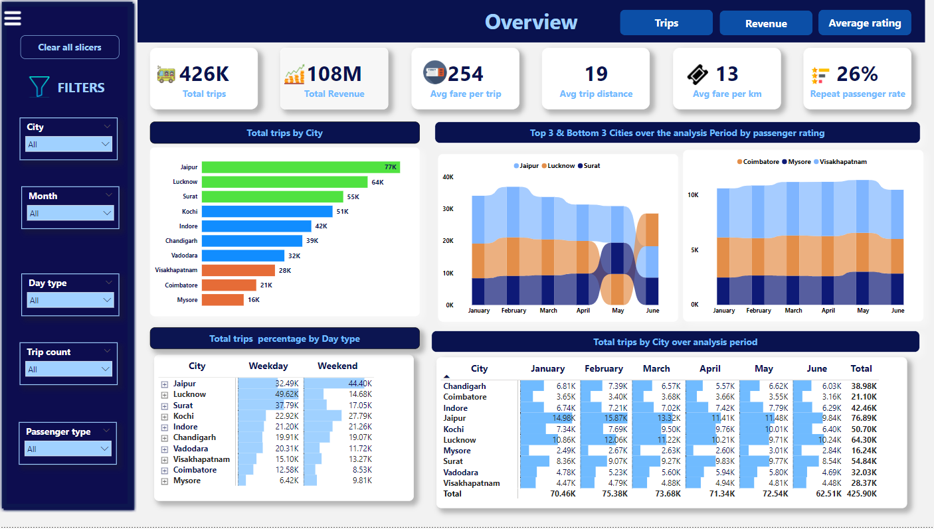

Slide 32
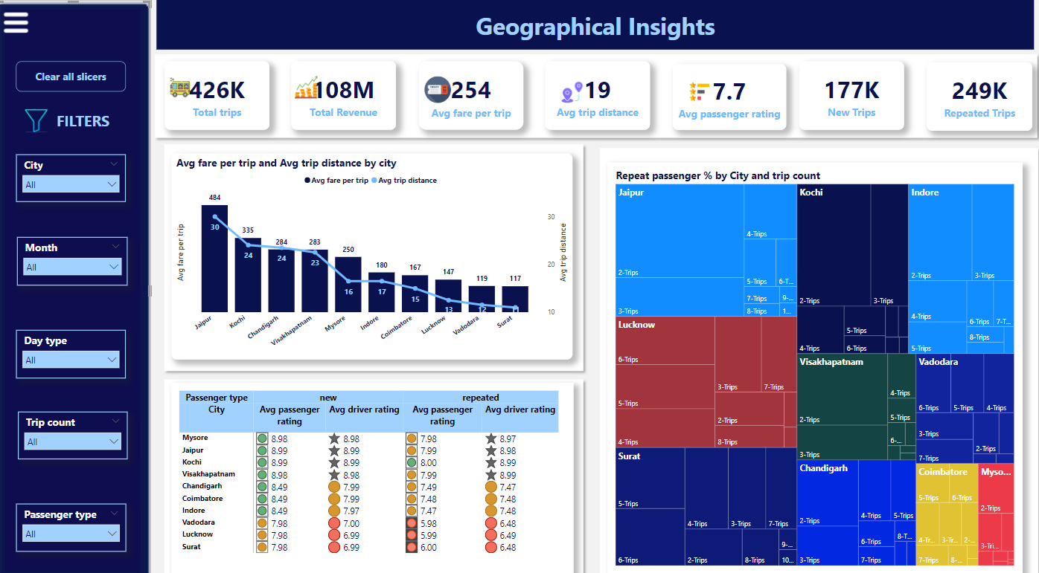

Slide 33
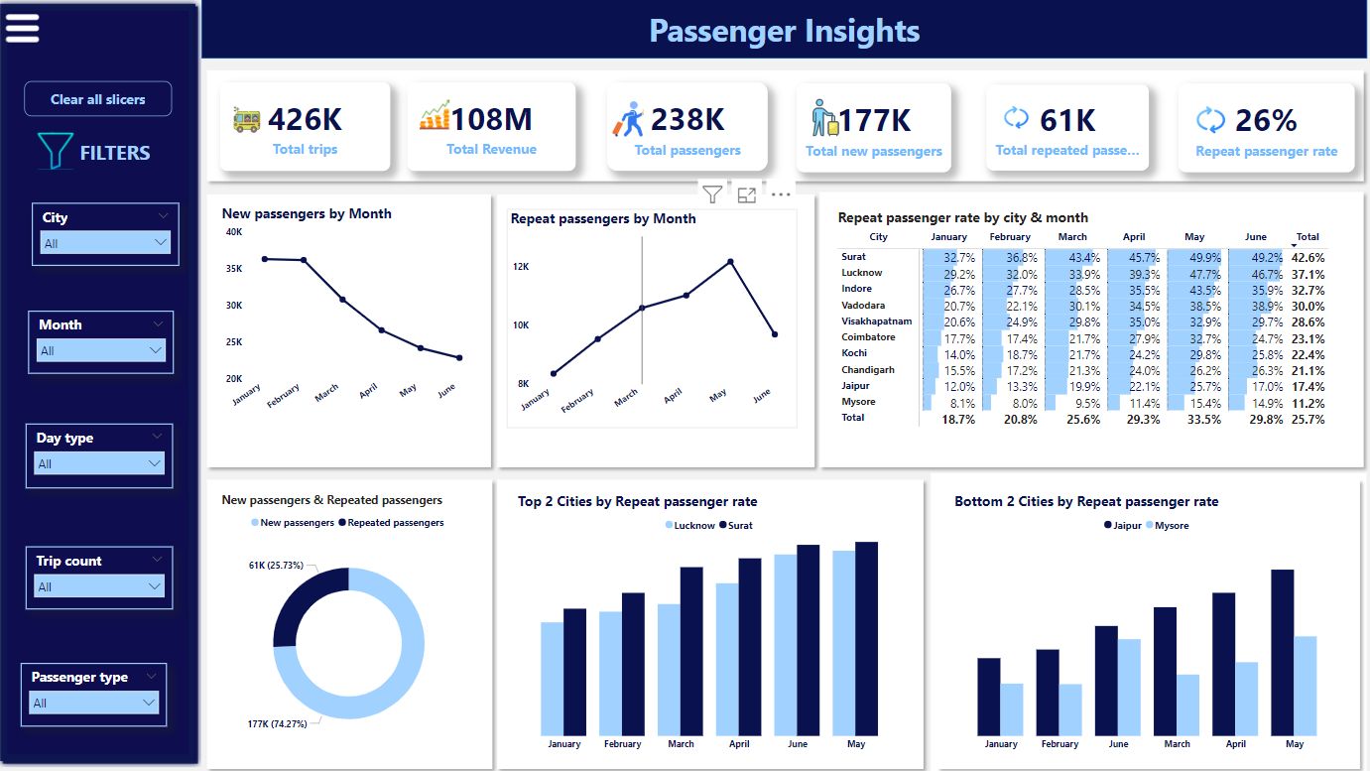

Slide 34
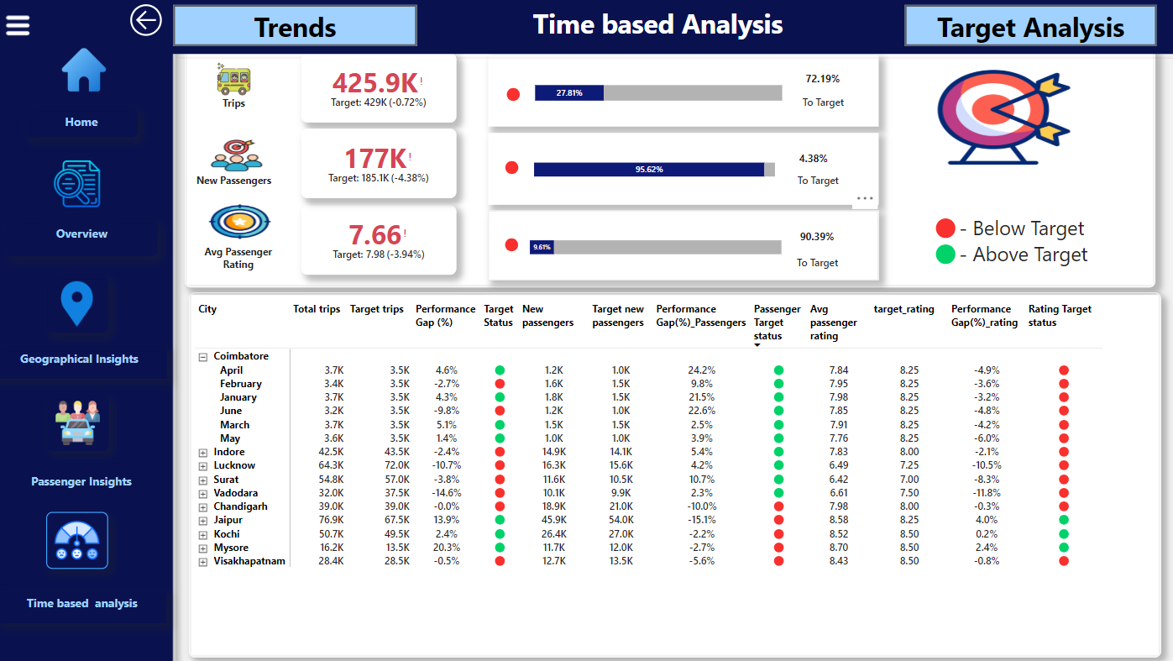

Slide 35

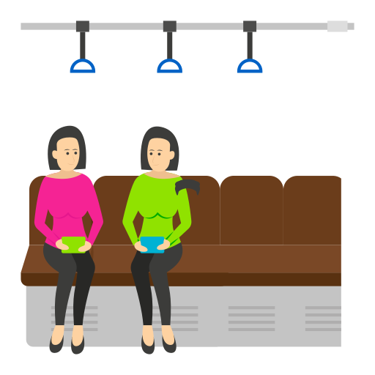

Key Insights
Trip Volume & Revenue
Peak Months: February & March show highest trip volume, with February leading (75.4K trips).
Top Revenue Cities: Jaipur, Kochi, and Chandigarh generate the most revenue, with Jaipur leading (37.2M).
Passenger Trends
Repeat Passengers: High in Surat (42.6%) and Lucknow (37.1%), but low in Jaipur (11.2%).
New Passengers: Highest in Jan-Feb, declining in May-June.
Fare & Trip Distance
Cities like Jaipur have higher fares (484) due to longer trips (30km),while Surat’s fare is lower (117) with shorter trips (11km).

Slide 36
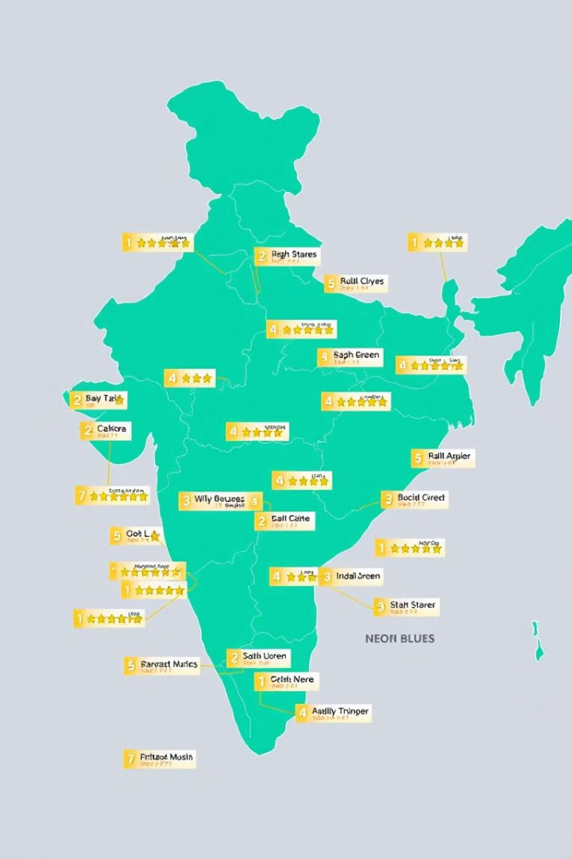




Key Insights (Continued)
Customer Ratings
Weekend vs Weekday Trends
Jaipur, Kochi, and Mysore have high ratings, while Lucknow, Surat, and Vadodara have low ratings.
Tourism cities have higher trip volume on weekends, while business cities have higher trip volume on weekdays.
Repeat Passenger Rate
City Performance Against Targets
Repeat passenger rates peak in May(33.5%) and June.
Business cities met passenger targets but missed trip volume and ratings targets, while tourism cities met trip targets but ratings were below target.

Slide 37
Recommendations
Improve Service Quality
1
Address customer complaints and improve driver behavior.
2
Dynamic Pricing Strategy
Optimize fares based on demand, city demographics, and competitor pricing.
Enhance Customer Retention
3
Increase repeat passenger rates through loyalty programs and improved service offerings.
4
Expand EV Fleet
Integrate eco-friendly vehicles in high-demand, environmentally-conscious cities.
Leverage Seasonal Trends
5
Prioritize marketing and promotions around peak months and weekends in tourism cities.
6
Tailored City-Specific Campaigns
Customize strategies based on city-specific behaviors to maximize trip volumes, revenue, and repeat passengers.

Slide 38

Thank you

